Slide 1
Data Structures and Algorithms
Simple sorting algorithms

Slide 2
Table of contents
Definitions
Bubble sort
Selection sort
Insertion sort
Search

Slide 3
Sorting and Searching
Fundamental problems in computer science and programming
Sorting is done to make searching easier
Multiple different algorithms to solve the same problem
Examples will use arrays of ints to illustrate algorithms

Slide 4
Bubble sort

Slide 5
Bubble sort
Sorting Algorithms are concepts that every competitive programmer must know. Sorting algorithms can be used for collections of numbers, strings, characters, or a structure of any of these types. Bubble sort is based on the idea of repeatedly comparing pairs of adjacent elements and then swapping their positions if they exist in the wrong order.

Slide 6
Bubble sort
Compare each element (except the last one) with its neighbor to the right
If they are out of order, swap them
This puts the largest element at the very end
The last element is now in the correct and final place
Compare each element (except the last two) with its neighbor to the right
If they are out of order, swap them
This puts the second largest element next to last
The last two elements are now in their correct and final places
Compare each element (except the last three) with its neighbor to the right
Continue as above until you have no unsorted elements on the left
https://www.hackerearth.com/practice/algorithms/sorting/bubble-sort/tutorial/

Slide 7
Example of bubble sort
7
2
8
5
4
2
7
5
4
8
2
5
4
7
8
2
4
5
7
8
2
7
8
5
4
2
7
5
4
8
2
5
4
7
8
2
4
5
7
8
2
7
8
5
4
2
5
7
4
8
2
4
5
7
8
(done)
2
7
5
8
4
2
5
4
7
8
2
7
5
4
8

Slide 8
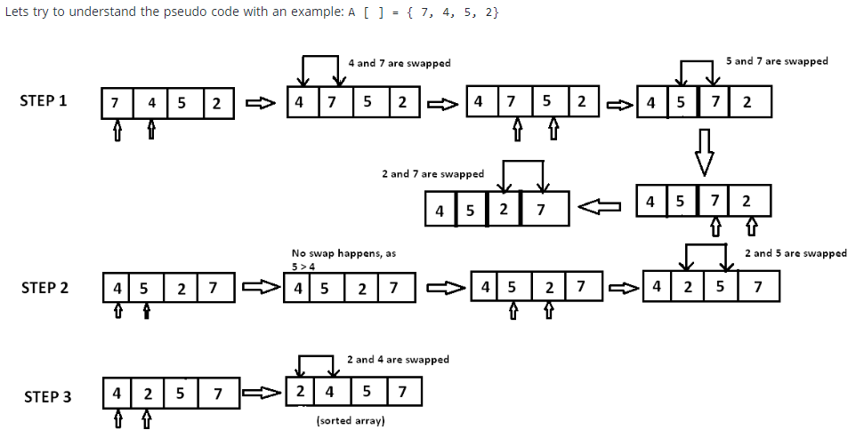
Example of bubble sort

Slide 9
Code for bubble sort
public static void bubbleSort(int[] a) { int outer, inner; for (outer = a.length - 1; outer > 0; outer--) { // counting down for (inner = 0; inner < outer; inner++) { // bubbling up if (a[inner] > a[inner + 1]) { // if out of order... int temp = a[inner]; // ...then swap a[inner] = a[inner + 1]; a[inner + 1] = temp; } } } }

Slide 10
Analysis of bubble sort
for (outer = a.length - 1; outer > 0; outer--) { for (inner = 0; inner < outer; inner++) { if (a[inner] > a[inner + 1]) { // code for swap omitted } } }
Let n = a.length = size of the array
The outer loop is executed n-1 times (call it n, that’s close enough)
Each time the outer loop is executed, the inner loop is executed
Inner loop executes n-1 times at first, linearly dropping to just once
On average, inner loop executes about n/2 times for each execution of the outer loop
In the inner loop, the comparison is always done (constant time), the swap might be done (also constant time)
Result is n * n/2 * k, that is, O(n²/2 + k) = O(n²)

Slide 11
Loop invariants
You run a loop in order to change things
Oddly enough, what is usually most important in understanding a loop is finding an invariant: that is, a condition that doesn’t change
In bubble sort, we put the largest elements at the end, and once we put them there, we don’t move them again
The variable outer starts at the last index in the array and decreases to 0
Our invariant is: Every element to the right of outer is in the correct place
That is, for all j > outer, if i < j, then a[i] <= a[j]
When this is combined with outer == 0, we know that all elements of the array are in the correct place

Slide 12
Selection sort

Slide 13
Selection sort
The Selection sort algorithm is based on the idea of finding the minimum or maximum element in an unsorted array and then putting it in its correct position in a sorted array.
https://www.hackerearth.com/practice/algorithms/sorting/selection-sort/tutorial/

Slide 14
Selection sort
Given an array of length n,
Search elements 0 through n-1 and select the smallest
Swap it with the element in location 0
Search elements 1 through n-1 and select the smallest
Swap it with the element in location 1
Search elements 2 through n-1 and select the smallest
Swap it with the element in location 2
Search elements 3 through n-1 and select the smallest
Swap it with the element in location 3
Continue in this fashion until there’s nothing left to search

Slide 15
Example and analysis of selection sort
The selection sort might swap an array element with itself--this is harmless, and not worth checking for
Analysis:
The outer loop executes n-1 times
The inner loop executes about n/2 times on average (from n to 2 times)
Work done in the inner loop is constant (swap two array elements)
Time required is roughly (n-1)*(n/2)
You should recognize this as O(n²)
7
2
8
5
4
2
7
8
5
4
2
4
8
5
7
2
4
5
8
7
2
4
5
7
8

Slide 16
Code for selection sort
public static void selectionSort(int[] a) { int outer, inner, min; for (outer = 0; outer < a.length - 1; outer++) { // outer counts down min = outer; for (inner = outer + 1; inner < a.length; inner++) { if (a[inner] < a[min]) { min = inner; } // Invariant: for all i, if outer <= i <= inner, then a[min] <= a[i] } // a[min] is least among a[outer]..a[a.length - 1] int temp = a[outer]; a[outer] = a[min]; a[min] = temp; // Invariant: for all i <= outer, if i < j then a[i] <= a[j] } }

Slide 17
Invariants for selection sort
For the inner loop:
This loop searches through the array, incrementing inner from its initial value of outer+1 up to a.length-1
As the loop proceeds, min is set to the index of the smallest number found so far
Our invariant is: for all i such that outer <= i <= inner, a[min] <= a[i]
For the outer (enclosing) loop:
The loop counts up from outer = 0
Each time through the loop, the minimum remaining value is put in a[outer]
Our invariant is: for all i <= outer, if i < j then a[i] <= a[j]

Slide 18
Insertion sort

Slide 19
Insertion sort
Insertion sort is based on the idea that one element from the input elements is consumed in each iteration to find its correct position i.e, the position to which it belongs in a sorted array.
It iterates the input elements by growing the sorted array at each iteration. It compares the current element with the largest value in the sorted array. If the current element is greater, then it leaves the element in its place and moves on to the next element else it finds its correct position in the sorted array and moves it to that position. This is done by shifting all the elements, which are larger than the current element, in the sorted array to one position ahead

Slide 20
Insertion sort
The outer loop of insertion sort is: for (outer = 1; outer < a.length; outer++) {...}
The invariant is that all the elements to the left of outer are sorted with respect to one another
For all i < outer, j < outer, if i < j then a[i] <= a[j]
This does not mean they are all in their final correct place; the remaining array elements may need to be inserted
When we increase outer, a[outer-1] becomes to its left; we must keep the invariant true by inserting a[outer-1] into its proper place
This means:
Finding the element’s proper place
Making room for the inserted element (by shifting over other elements)
Inserting the element

Slide 21
One step of insertion sort
sorted
next to be inserted
3
4
7
12
14
14
20
21
33
38
10
55
9
23
28
16
temp
less than 10
10
3
4
7
10
12
14
14
20
21
33
38
55
9
23
28
16
sorted

Slide 22
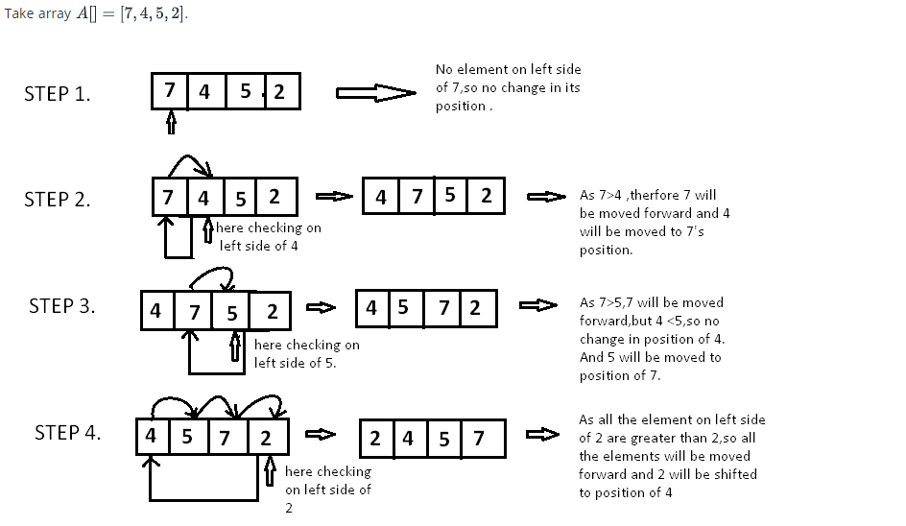
Example of insertion sort

Slide 23
Code for insertion sort
void insertion_sort ( int A[ ] , int n) { for( int i = 0 ;i < n ; i++ ) { /*storing current element whose left side is checked for its correct position .*/ int temp = A[ i ]; int j = i; /* check whether the adjacent element in left side is greater or less than the current element. */ while( j > 0 && temp < A[ j -1]) { // moving the left side element to one position forward. A[ j ] = A[ j-1]; j= j - 1; } // moving current element to its correct position. A[ j ] = temp; } }

Slide 24
Analysis of insertion sort
We run once through the outer loop, inserting each of n elements; this is a factor of n
On average, there are n/2 elements already sorted
The inner loop looks at (and moves) half of these
This gives a second factor of n/4
Hence, the time required for an insertion sort of an array of n elements is proportional to n²/4
Discarding constants, we find that insertion sort is O(n²)

Slide 25
Merge sort

Slide 26
Merge sort
Merge sort is a divide-and-conquer algorithm based on the idea of breaking down a list into several sub-lists until each sublist consists of a single element and merging those sublists in a manner that results into a sorted list.
Idea:
Divide the unsorted list into sublists, each containing element.
Take adjacent pairs of two singleton lists and merge them to form a list of 2 elements. will now convert into lists of size 2.
Repeat the process till a single sorted list of obtained.
https://www.hackerearth.com/practice/algorithms/sorting/merge-sort/tutorial/

Slide 27
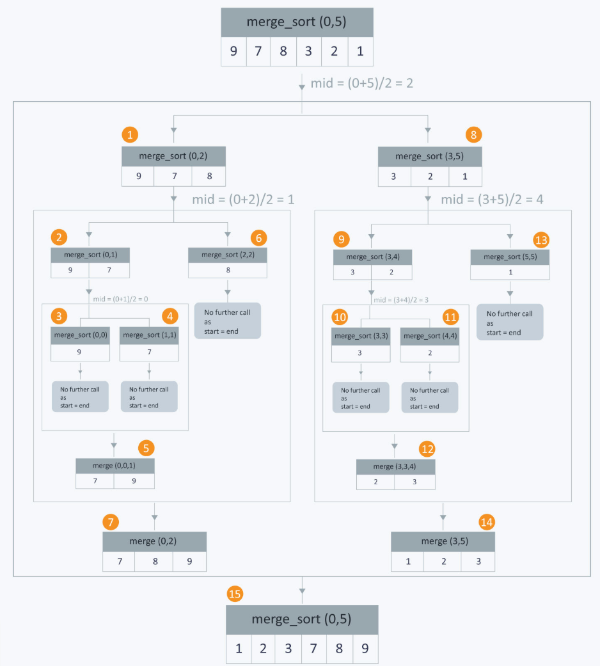
Merge sort

Slide 28
Heap sort

Slide 29
Heap sort
Heaps can be used in sorting an array. In max-heaps, maximum element will always be at the root. Heap Sort uses this property of heap to sort the array.
Consider an array which is to be sorted using Heap Sort.
Initially build a max heap of elements in Arr.
The root element, that is Arr[1], will contain maximum element of Arr. After that, swap this element with the last element of Arr and heapify the max heap excluding the last element which is already in its correct position and then decrease the length of heap by one.
Repeat the step 2, until all the elements are in their correct position.
https://www.hackerearth.com/practice/algorithms/sorting/heap-sort/tutorial/

Slide 30
Search algorithms
Linear search
Binary Search
Binary Search
Recursive Binary Search
Interpolation Search
Indexed Searching
Binary Search Trees
Hash Table Searching
Grover's Algorithm
Best-first

Slide 31
Linear search
Linear search is used on a collections of items. It relies on the technique of traversing a list from start to end by exploring properties of all the elements that are found on the way.
Example pseudo code:
for(start to end of array) { if (current_element equals to 5) { print (current_index); } }

Slide 32
Binary Search
Binary search is the most popular Search algorithm.It is efficient and also one of the most commonly used techniques that is used to solve problems.
If all the names in the world are written down together in order and you want to search for the position of a specific name, binary search will accomplish this in a maximum of 35 iterations.
Binary search works only on a sorted set of elements. To use binary search on a collection, the collection must first be sorted.
https://www.hackerearth.com/practice/algorithms/searching/binary-search/tutorial/

Slide 33
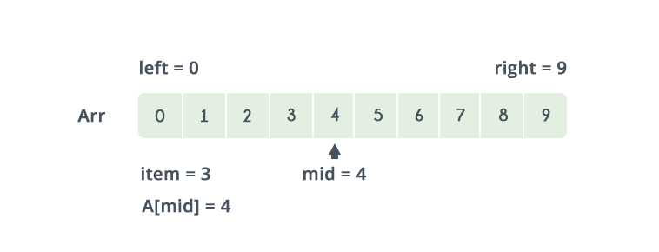
Binary search

Slide 34
Summary
Bubble sort, selection sort, and insertion sort are all O(n²)
We can do much better than this with somewhat more complicated sorting algorithms
Within O(n²),
Bubble sort is very slow, and should probably never be used for anything
Selection sort is intermediate in speed
Insertion sort is usually the fastest of the three--in fact, for small arrays (say, 10 or 15 elements), insertion sort is faster than more complicated sorting algorithms
Selection sort and insertion sort are “good enough” for small arrays

Slide 35
Resources
http://www.sorting-algorithms.com/
https://www.cs.usfca.edu/~galles/visualization/Algorithms.html
https://visualgo.net/bn/sorting

